Slide 1
2025 Trends to Watch: Telco AI and Analytics
Roz Roseboro
Principal Analyst, Telco Software and AI
askananalyst@omdia.com

Slide 2
“With clarity on which processes benefit most from AI, CSPs’ AIOps journeys are now underway.”
Roz Roseboro Principal Analyst, Telco Software and AI

Slide 3
Contents
Key messages
Key recommendations
Generative AI hype dies down, and CSPs face the hard work needed to make it a reality
AI makes advances in automating network operations
Data management comes to the fore as CSPs look for ways to drive revenue growth
Appendix

Slide 4
Key messages
Generative AI (GenAI) hype dies down, and CSPs face the hard work needed to make it a reality.
Leading communications service providers (CSPs) have discovered that generic large language models (LLMs) can work for many telco use cases. They are gaining skills in fine-tuning, prompt-engineering, and retrieval-augmented generation (RAG) and reaping the benefits. Others must now follow suit or risk being left behind.
AI makes advances in automating network operations.
CSPs continue their journey toward autonomous operations, and artificial intelligence (AI) plays an increasingly important role. CSPs have been gaining clarity on which processes will benefit most from AI and slowly but steadily starting down the road to AIOps.
Data management comes to the fore as CSPs look for ways to drive revenue growth.
The AI revolution is forcing CSPs to take a hard look at the quality of their data. Most realize that this data holds the key to insights that could help them create new offers to drive new revenue. They must find it, cleanse it, and standardize it before AI can work its magic.
1
2
3

Slide 5
Key recommendations
Service providers
All CSPs should be using GenAI to improve operational efficiencies. The technologies—though not perfect—have now proven their worth, and the lessons learned today will pay dividends in the future. Those that wait risk being left behind. CSPs should use AI to automate as many network operational processes as they can, but be realistic about what is most feasible. Closed-loop operation does not necessarily make sense in the near term for every process. Asking their vendors to provide explainability in their solutions will help build confidence among operations staff. Getting the data in top shape should be job number one. CSPs should then start the conversations necessary to get support for data sharing across various groups within the organization. Building trust will take time, so the sooner this process starts, the better.
Vendors
Vendors should consider developing small language models (SLMs) that focus on narrow, telco-specific use cases. SLMs may become a more appealing option for CSPs and could also prove to be a faster route to market for smaller vendors. Vendors should incorporate AI into their OSS/BSS so it supports several operational processes to maximize the value to CSPs looking to improve efficiencies and simplify their environments. Ensure your solutions have explainable AI so CSPs can build confidence in the recommendations coming from those systems. Vendors should do all they can to help CSPs easily manage their OSS/BSS data in cloud environments. They should also provide visualization capabilities so people outside the networks team can engage with unfamiliar network data in combination with customer and other business-related data.

Slide 6
GenAI hype dies down, and CSPs face the hard work needed to make it a reality

Slide 7
CSPs’ actions do not always match their vision
97%
15%
45%
25%
CSPs expressing confidence that GenAI will have a positive impact within two years
CSPs that have defined KPIs for their GenAI projects
CSPs that are still developing their data governance process
CSPs that already have a budget in place for GenAI projects
Source: Omdia
© 2024 Omdia

Slide 8
CSPs need to define outcomes and KPIs, dedicate budget, and establish data governance to achieve their AI ambitions
Articulate the desired business outcome
Dedicate budget for project
Must have a process in place in advance to ensure proper lifecycle management of the data over time
Identify business problem
Achieve desired business goals
Must have a way to determine whether the project is having the desired impact
Define KPIs to quantify results
Establish data governance process
Source: Omdia
© 2024 Omdia

Slide 9
The time is now for CSPs to get moving on their GenAI journey
By the start of 2024, the industry was convinced of the value of generative AI, seeing its potential to transform network and business operations. However, many felt a telco-specific LLM was needed to provide actionable results. The Global Telco AI Alliance, launched in February by Deutsche Telekom, e& Group, Singtel, SoftBank, and SK Telecom, set to work to develop one to be delivered in June. At the time of writing, it has not been delivered.
In the meantime, other CSPs including Bell Canada, BT, Orange, Telstra, Verizon, and Vodafone moved forward using RAG, fine-tuning, and prompt-engineering to get meaningful results from generic foundational models.
With the exception of a handful of CSPs in South Korea, Japan, and India, few have expressed an intent to develop their own LLMs. However, many are partnering with leading infrastructure provider NVIDIA to ensure they have access to the rare GPUs in order to train and run their models. Omdia also expects to see CSPs and the broader industry begin to develop small language models (SLMs) that address targeted use cases in areas such as billing and network management.
Though issues of bias, privacy, security, and control have not been completely addressed, CSPs are not waiting and should not wait to start on their GenAI journey. Selecting internal-facing use cases to get comfortable with the technologies is a way to minimize risk while building skills that can be applied to customer-facing use cases later.
Vendors have been adding more explainable AI capabilities into their products to help CSPs become more comfortable with the recommendations AI makes, and more visualization and natural language interfaces to make them more accessible to a wider range of users. CSP that have been waiting on the sidelines must now follow the early adopters or risk being left behind.

Slide 10

GenAI will make its way into more areas of CSP operations
Player type | What will the impact be? | Impact rating | How should players respond?
Service providers | Having seen that existing LLMs are sufficient for many use cases, we expect CSPs that have never used GenAI will start using it for internal use cases such as customer care. Those that have already deployed GenAI will expand into additional use cases on the network side, but most will still be internal facing. With the exception of a modest number of GPU-as-a-service offerings, GenAI will not drive meaningful revenue in the coming year. |  | CSPs that have been waiting on the sidelines need to get going. The operational efficiency gains of GenAI have been proven and are nontrivial. The foundations being laid today will pay dividends in the future, and those that wait risk being left behind once GenAI becomes more relevant from a revenue-generation perspective.
Vendors | Vendors that have banked on making it easier for CSPs to engage with LLMs may find their opportunities limited, because they have found it is possible to use RAG, fine-tuning, and prompt-engineering to get what they need. CSPs may make GenAI functionality a requirement for their telecom IT software as the potential efficiency gains become more apparent. |  | Vendors should consider developing small language models (SLMs) that focus on narrow, telco-specific use cases. As the financial and energy costs of LLMs become an issue, SLMs may become a more appealing option for CSPs. They could also prove to be a faster route to market for smaller vendors looking for an entry point into a competitive telecom IT landscape.
Source: Omdia |  |  | © 2024 Omdia
+2
+1
−
-1
-2
+2
+1
−
-1
-2

Slide 11
AI makes inroads in automating network operations

Slide 12
AI will play an increasingly important role in CSP network operations
It is still early days on the road to AIOps. In April 2024, around half the respondents to an Omdia survey indicated that they are in the trialing or planning stage of AIOps, and about 20% are formulating a strategy. Only 13% have implemented their strategy. Operator size and type did not have any impact on the results.
Some of the characteristics of CSPs that are trialing or have already implemented AIOps included a view that accessing network data using natural language is very valuable; they are also much more likely than other CSPs to have point solutions for analytics and are much more likely to say that adding AI to network analytics systems was very important.
CSPs expect that adding AI to analytics tools will allow them to process data more quickly. This could lead to optimization in real time or near-real time, which has many knock-on effects, including energy efficiency and customer satisfaction. The same applies to troubleshooting.
The next slide shows that optimization, troubleshooting, and monitoring are the top three processes that CSPs expect AI will play a key role in automating in the next two years. Among CSPs that have already implemented or are trialing AIOps, upgrading replaces troubleshooting in third place.
CSPs do not yet appear to be comfortable letting AI implement changes to the network, as evidenced by the low ranking for healing. They do, however, appear to be comfortable with AI finding faults, but they still want a human in the loop.
GenAI looks as if it will be used more as an interface than an execution agent. In a separate survey, most respondents viewed GenAI’s potential as a user interface to deterministic orchestration systems—translating user intent to system instructions—and only a third thought GenAI could be used to solve networking problems. Those results were unchanged from the prior year.

Slide 13
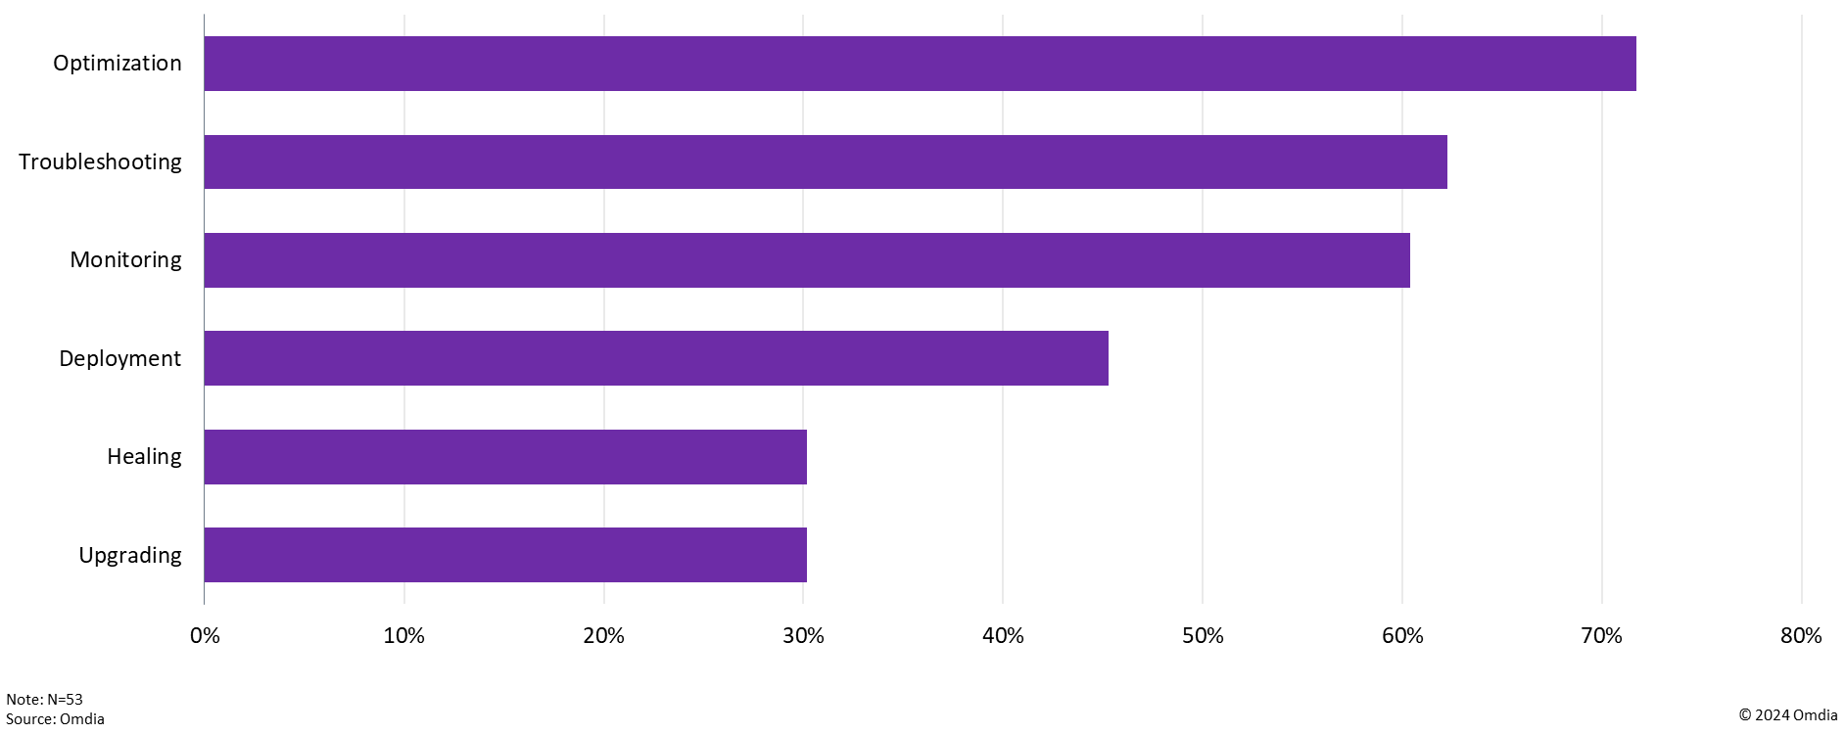
In the next two years, which network processes will AI play a significant role in automating?

Slide 14
AI will play an increased role in automating network operations
Player type | What will the impact be? | Impact rating | How should players respond?
Service providers | With more automation, presumably, comes fewer errors, faster troubleshooting, and quicker service activation. However, Omdia believes that it will be some time before CSPs are comfortable giving complete control to systems to execute the recommendations coming from AI. Automated systems will, instead, perform more basic tasks, such as configurations (once humans have approved them) and determining root causes of problems, leaving humans to carry out recommendations. This will still lead to cycle time reductions and higher quality of service that could drive customer satisfaction improvements. Whether those will lead to revenue gains is a separate question. |  | CSPs should push their vendors to provide more explainability in their AI-enabled OSS and BSS solutions. This will help them gain confidence in the results coming from their AI systems and in moving more processes to closed-loop automation. They should also make clear to management that automation will not come overnight, so headcount reductions (and the requisite cost savings) will not be immediately forthcoming, and nor should they be. The institutional knowledge within network operations staff will take years to transfer to AI.
Vendors | As CSPs automate more of their network operational processes, demand for telecom IT software will begin to decline, because CSPs will use this opportunity to modernize and simplify their OSS/BSS environments. Over time, as AI becomes more intelligent and able to learn, CSPs may not need as many upgrades as they have in the past, putting a damper on the service/maintenance revenue vendors have come to expect. |  | In the near term, vendors should work to AI-enable their OSS/BSS so it can support as many operational processes as possible, with a focus on explainability so CSPs are comfortable using it. In the longer term, they should consider pricing models to account for AI’s ability to learn over time and the impact that may have on service revenue.
Source: Omdia |  |  | © 2024 Omdia
+2
+1
−
-1
-2
+2
+1
−
-1
-2

Slide 15
Data management comes to the fore as CSPs look for ways to drive revenue growth

Slide 16
Data management will be key to unlocking the value of network and customer data
To date, most AI use cases have focused on improving operational efficiency. What CSPs really need, however, is to boost the revenue side of the equation. They know that by combining network data with customer behavior, they can obtain valuable insights that over-the-top (OTT) and hyperscaler competitors cannot replicate, which is a much-needed competitive advantage.
However, before that can happen, they must ensure that the data is of high quality. In network analytics systems, data mediation converts the data collected from various sources into a format that can be understood by the consumers of this data. All nonrelevant data is filtered out, and the what remains is enriched with additional information. The data is complete and not duplicated. It must then be normalized, meaning it must be converted into a single consistent format.
CSPs face considerable challenges in standardizing and cleansing data, given the vast amounts, complexity, and disparate ownership of the data they have. Because so much of that data resides in siloes across the organization, even knowing that data exists can also present a challenge.
Ongoing data governance is critical to ensure quality results from AI tools and to maintain compliance with AI regulations on privacy and data sovereignty.
As seen on the next slide, Omdia’s research reveals that CSPs are well aware of these challenges.

Slide 17
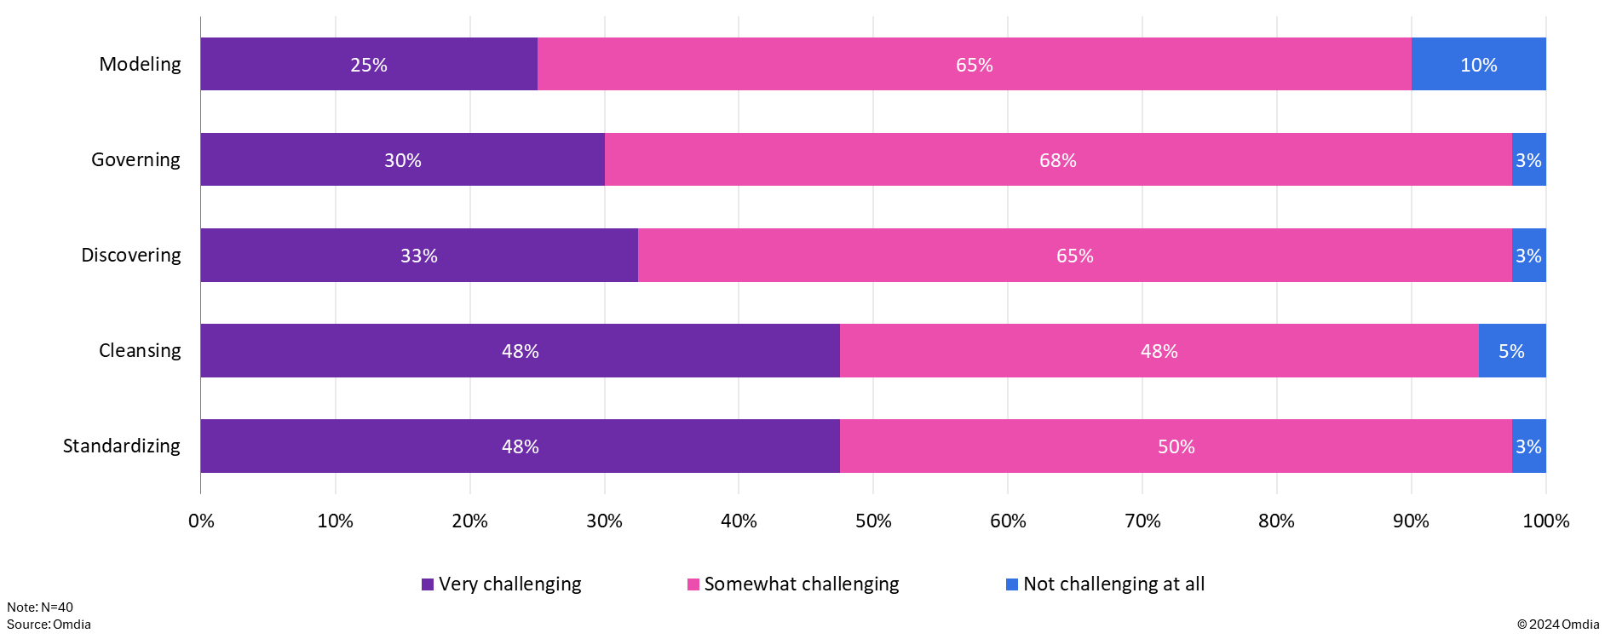
How challenging are the following aspects of data management?

Slide 18
CSPs will struggle to use data to drive revenue growth
Player type | What will the impact be? | Impact rating | How should players respond?
Service providers | Omdia expects the impact to be uneven. The early adopters that have already cleansed and standardized their data and established strong data governance processes will be in a better position, although getting widespread organizational buy-in to share data is not automatically guaranteed. Those CSPs with C-level support for data-sharing initiatives will see benefits soonest. Those that have not laid a solid data foundation will not be able to take advantage of the most promising revenue-generating use cases. |  | Getting the data into top shape should be job number one. Regardless of the condition of their data estates, however, all CSPs should start the conversations necessary to get support for data sharing across various groups within the organization. Building trust will take time, so the sooner this process starts, the better.
Vendors | Vendors have an opportunity to help their CSP customers get their data estates in order. The easier vendors can make it for CSPs to discover, cleanse, standardize, and manage their data over time, the more valuable the data is, and the more valuable the vendor’s solution will be. There could be a negative impact on vendors whose products are not cloud-enabled, because CSPs will store and manage their data on a public or private cloud. |  | Vendors should build tools into their products to help CSPs easily manage their data in cloud environments, from ingestion through to processing. Visualization capabilities should be provided so that people outside the networks team can engage with unfamiliar network data in combination with customer and other business-related data.
Source: Omdia |  |  | © 2024 Omdia
+2
+1
−
-1
-2
+2
+1
−
-1
-2

Slide 20
Appendix
Methodology
This report was produced through a combination of primary and secondary research. Primary research included briefings and industry surveys. Secondary research included conference presentations and publicly available information. In addition, various Omdia databases and forecasts were used.
Further reading
2025 Trends to Watch: Telco Software (November 2024)
Telecoms IT Market Forecast Report: 2024–29 (August 2024)
The evolution of network analytics systems: How AI is changing their roles (August 2024)
State of Play of AI in Telecoms – Mid-2024 Update (July 2024)
GenAI in Telecoms: Survey and Report – 2024 (February 2024)
Author
Roz Roseboro, Principal Analyst, Telco Software and AI
askananalyst@omdia.com

Slide 21
Appendix
Omdia consulting
We hope that this analysis will help you make informed and imaginative business decisions. If you have further requirements, Omdia’s consulting team may be able to help you. For more information about Omdia’s consulting capabilities, please contact us directly at consulting@omdia.com.
Citation policy
Request external citation and usage of Omdia research and data via citations@omdia.com.

